Slide 1

Hotel Booking Analysis
Nitturi Preethi sharon rose

Slide 2
Contains
Data Summary
MECE Approach
Setting Up Work Space
Data Cleaning
EDA Analysis
Power Bi
Dashboard
Insights

Slide 3
Data Summary
Given data set has 119390 rows and 32 different columns of variables crucial for hotel booking analysis. It as the information on hotel booking details, guest details, meal preferences, booking source, room details and reservation statues.
Hotel: This column as the category of hotels i.e. Resort Hotel and City Hotel.
Is_cancelled: This column shows the booking is cancelled or not cancelled by values 1, 0, where 0 indicates not cancelled and 1 indicates cancelled
Lead_time: the time between reservation and actual arrival
Arrival_date_year, Arriva_date _month, Arrival_date_of week number, Arrival_date_day_of_month: All these four columns have the year, month week number and date of the arrival.
Stayed_in_weekend_nights: This column has the no of weekend nights stay per reservation.

Slide 4
Data Summary Cont….
Stayed_in_weekday_nights: This column has the no of weekday nights stay per reservation.Country: The origin country of guest.
Market_segment: This column show how reservation was made and purpose of reservation eg, corporate means corporate trip, TA for travel agency.
Distribution_channel: This column shows the medium throuht booking was made. I,e, direct, corporate, TA/To, undefined, GDS.
Is_repeated_guest: Shows if the guest is who has arrived earlier or not values 0 and 1, where 0 indicates No, 1 indicates repeated guest.
Previous_cancellation: This shows the no of booking cancelled.
Previous_bookings_not_cancelled: Shows the no of booking that are not cancelled.

Slide 5
Data Summary Cont….
Deposit_type: This column gives the info regarding the type of deposit i.e. no deposit, no refund, refundable.
Agent: This column as the agent code.
Company: This column as the company code.
Day_in_waiting_list: This has the no of days in waiting list.
Customer_type: It shows the type of customer i.e. contract, group, transient and transient_party.
Adults: shows the no of adults.
Children: shows the no of children.
Babies: shows the no of babies.

Slide 6
Data Summary Cont….
Meal: Meal preferences per reservation i.e. BB, FB, HB SC, Undefined.
Adr: It shows the average daily rate(ADR).
Required_car_parking_spaces: This column shows the No of request made by the for car parking spaces.
Total_of_special_request: This column shows the no of special request made.
Reservation_status: Shows the reservation statues i.e. check out and check in.
Reserved_room_type: The room type reserved while booking.
Assigned_room_typr: The room assigned at the moment of arrival.
Booking Changes: No.of changes made while booking.

Slide 7
MECE Approach
BOOKING PATTERNS and TRENDS | GUEST PREFERENCE | CANCELLATION ANALYSIS | ROOM ALLOCATION and MODIFICATION | BOOKING SOURCES and REVENUE
Analyse booking data to identify trends in the no of booking over time | Analyse type of meal booked | Analyse the impact of deposit type | Analyse room allocation dynamics | Analyse revenues generated from different sourness
Categorize booking by hotel type (resorts hotel and city hotel) | Examine special requests made by guests and their frequency | Calculating the cancellation rate and identify factors influencing cancellation | Calculate the no of changes made to booking and their impact on revenue | Explore the historical behaviour of guest
Analyse seasons variations in booking patterns (by week number and day of week | Analysing the composition of guest (no of adults, children and babies) | Explore the relationship between booking agent Ids and cancellation | Investigate the impact of room modification on guest satisfaction | Investigate the influence of customers on revenue.
Calculate the average lead time for booking | Analyse the car parking space requirement | Determine if repeated guests have a lower cancellation rate |  | Calculate revenue per available room and revenue per guest.

Slide 8
Setting Up Work Space
Visit the official MySQL website to download the MySQL installer. You can find it at https://dev.mysql.com/downloads/install. Select the appropriate version for your operating system (Windows, macOS, or Linux) and follow the download instructions and install.
After a successful installation, you can access MySQL Workbench.
Menu Bar: The menu bar at the top contains various options for managing and configuring MySQL.
Navigator Section: On the left-hand side, you will find the navigator section. Here, you can see a list of databases, connections, and server management options.
Query Section: In the center, you'll have the Query section. This is where you can write and execute SQL queries against your databases.

Slide 9
Setting Up Work Space Cont.…
Output Section: At the bottom, you will find the Output section. This area displays the results and outputs of your SQL queries, including any error messages or query results.
Now create the database using the command create database name or by the using the menu later on load the CSV data set to the working space.

Slide 10
Data Cleaning
Data cleaning involves checking duplicates, finding blanks and replacing with appropriate values, in other cases dropping the row or column, and also checking the datatypes and making changes.
Duplicates: The dataset is having 119390 rows and 32 columns among them there are no duplicates.
Blanks and Replacing: There are 488 blanks in country column which are replaced by “OTHR”, agent is having blanks of 16340 replaced by most frequently occurred values.
Inserting: Country table is inserted by “OTHR” , “Other”.
Drop: Company column is having 112593 blank rows i.e. more than 75% of data is blank or null so dropping the column is appropriate and this column is no where used for the analysis.

Slide 11
Data Cleaning Cont….
Data Type: the column children is float datatype so change it to int type, adr column is also having float datatype change it to int type, and Reservation_date column is of text type change to date type.

Slide 12
Exploratory Data Analysis
Exploratory Data Analysis (EDA) for the provided problem statement involves a thorough examination of various aspects of the dataset to uncover insights and trends related to booking patterns, guest preferences, and cancellation factors.
In this EDA session, we've addressed critical questions related to our dataset, aiming to extract insights crucial for informed decision-making and future development strategies. We've employed SQL queries as our primary analytical tool, with some queries providing direct solutions to EDA questions. However, in certain instances, the SQL outputs have been further refined using Excel, allowing us to gain deeper insights and identify patterns within the data.
Additionally, the use of filters and pivot tables has been instrumental in visualizing the information, enhancing our understanding of the dataset, and enabling us to rectify any identified drawbacks efficiently. This comprehensive approach ensures that we harness the full potential of our data for strategic improvements and optimized operations.

Slide 13
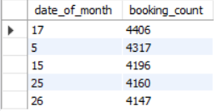
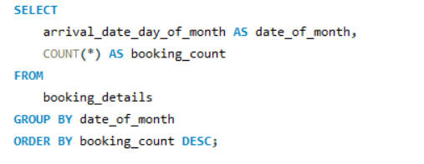
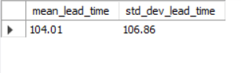
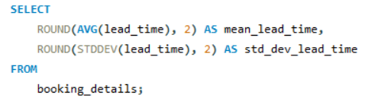
Exploratory Data Analysis Cont….
Understand the distribution of arrival dates, including the most common arrival days and summary statistics for lead times.

Slide 14
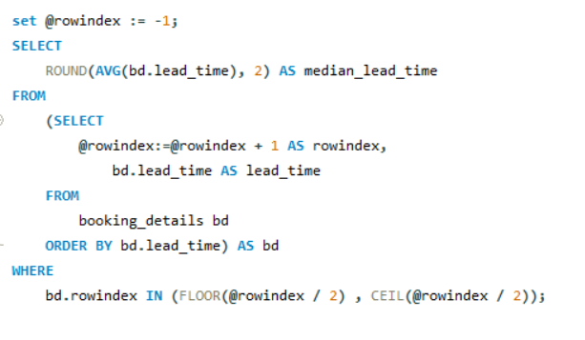
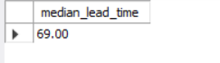
Exploratory Data Analysis Cont….
Median

Slide 15
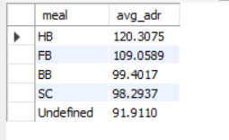
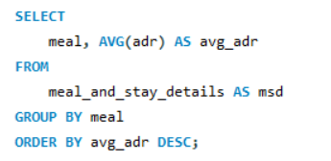
Exploratory Data Analysis Cont….
Analyse Average Daily Rates (ADR) by meal plan type to identify variations in pricing.
These is no data for pricing of different meals to analyse the pricing variations.

Slide 16
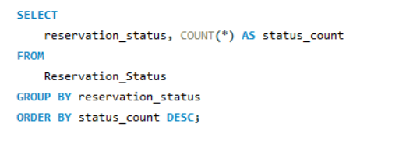
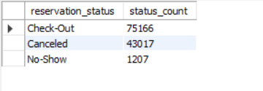
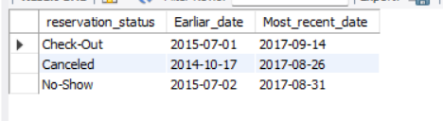
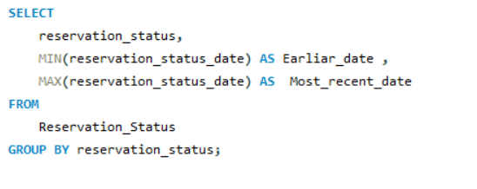
Exploratory Data Analysis Cont….
Examine whether guests who make multiple bookings have consistent room type preferences or if their preferences change over time.

Slide 17
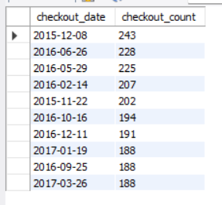
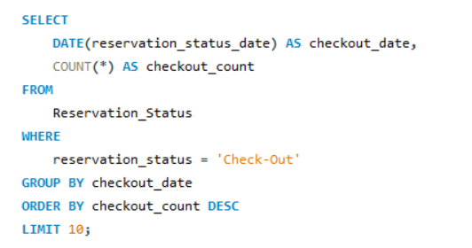
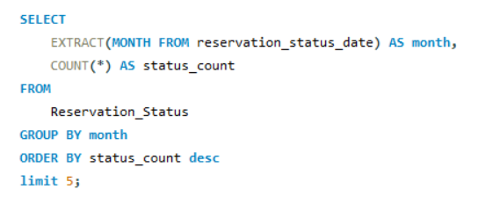
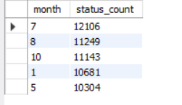
Exploratory Data Analysis Cont….
.Understand the distribution of reservation statuses and calculate summary statistics for reservation status dates.

Slide 18
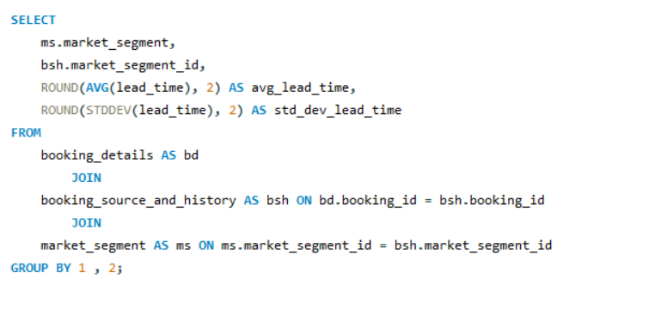
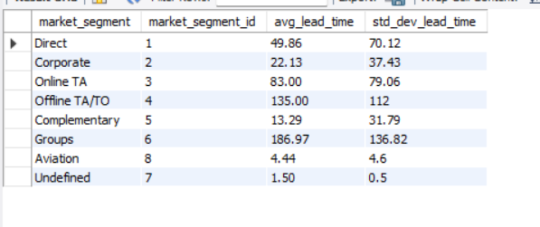
Exploratory Data Analysis Cont….
Compare the distribution of meal plans among different customer types (e.g., Transient, Group) to identify preferences.

Slide 19
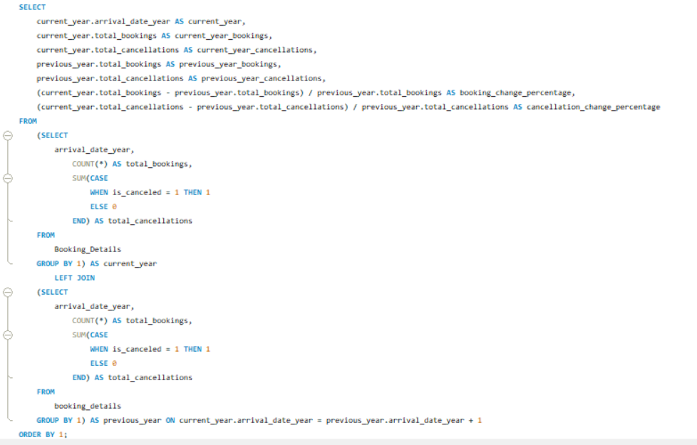
Exploratory Data Analysis Cont….
Analyze how booking patterns have evolved over the years, including year-over-year changes in bookings and cancellations.

Slide 20
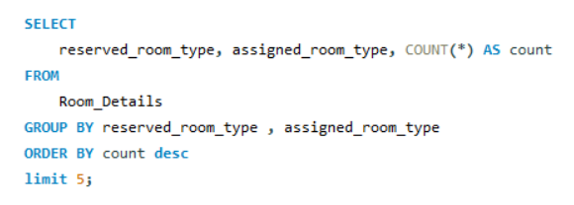
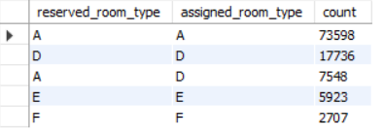
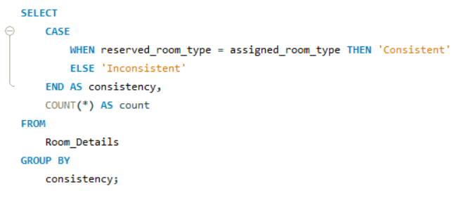
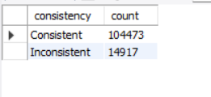
Exploratory Data Analysis Cont….
Explore the impact of a guest's booking history on their likelihood of cancelling a current booking. Calculate cancellation rates based on previous cancellations and noncanceled bookings

Slide 21
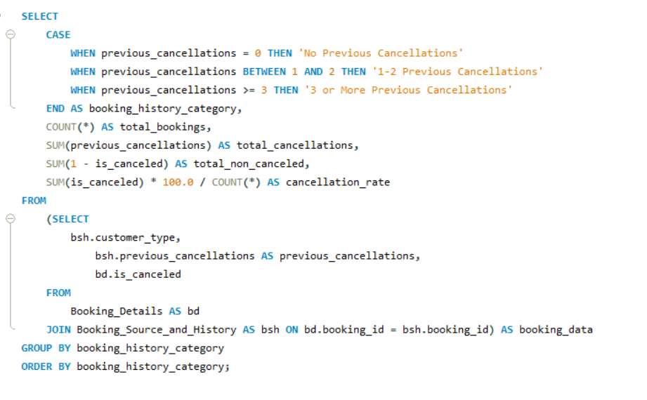
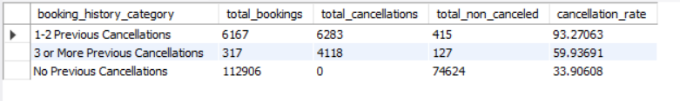
Exploratory Data Analysis Cont….
Calculate the proportion of repeated guests and investigate their booking behaviour. Identify any patterns or differences in preferences compared to first-time guests.

Slide 22
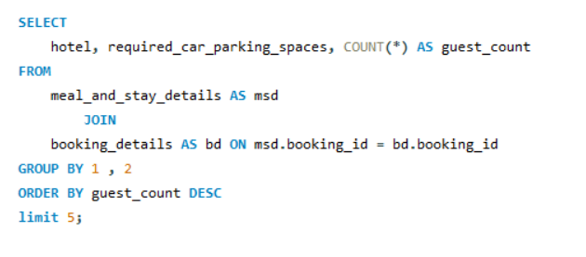
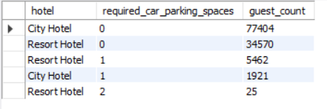
Exploratory Data Analysis Cont….
Analyse the distribution of required car parking spaces for each hotel type and determine if one type attracts more guests with cars.

Slide 23
Power Bi
In this session, we have comprehensive information on hotel bookings, guest details, and reservation statuses, allowing us to analyze booking patterns, guest preferences, and cancellation factors. Utilizing Power BI, we've created an interactive dashboard with eye-catching visuals to answer exploratory data analysis (EDA) questions and optimize hotel operations effectively.
The process begins by installing Power BI through the provided link (https://powerbi.microsoft.com/en-in/downloads/). Afterward, we load the cleaned CSV files from the initial data cleaning session into Power BI. These CSV files serve as the foundation for creating informative and interactive reports and visuals within the Power BI platform.

Slide 24
Power Bi Cont….
Interactive reports leverage the power of sliders, providing users with a highly effective means to influence data-driven decision-making. Well-designed sliders enable users to precisely filter and manipulate data, ultimately streamlining the decision-making process. These interactive elements enhance user engagement by putting data control in the hands of the users, facilitating a more intuitive and insightful exploration of information.
Alongside sliders, navigation buttons play a pivotal role in an interactive report. They significantly improve the user experience by simplifying transitions between different report sections or slides. This intuitive navigation ensures that users can seamlessly access and assimilate critical insights, ultimately bolstering the decision-making process and making interactive reports an invaluable tool for data-driven decision-makers.

Slide 25
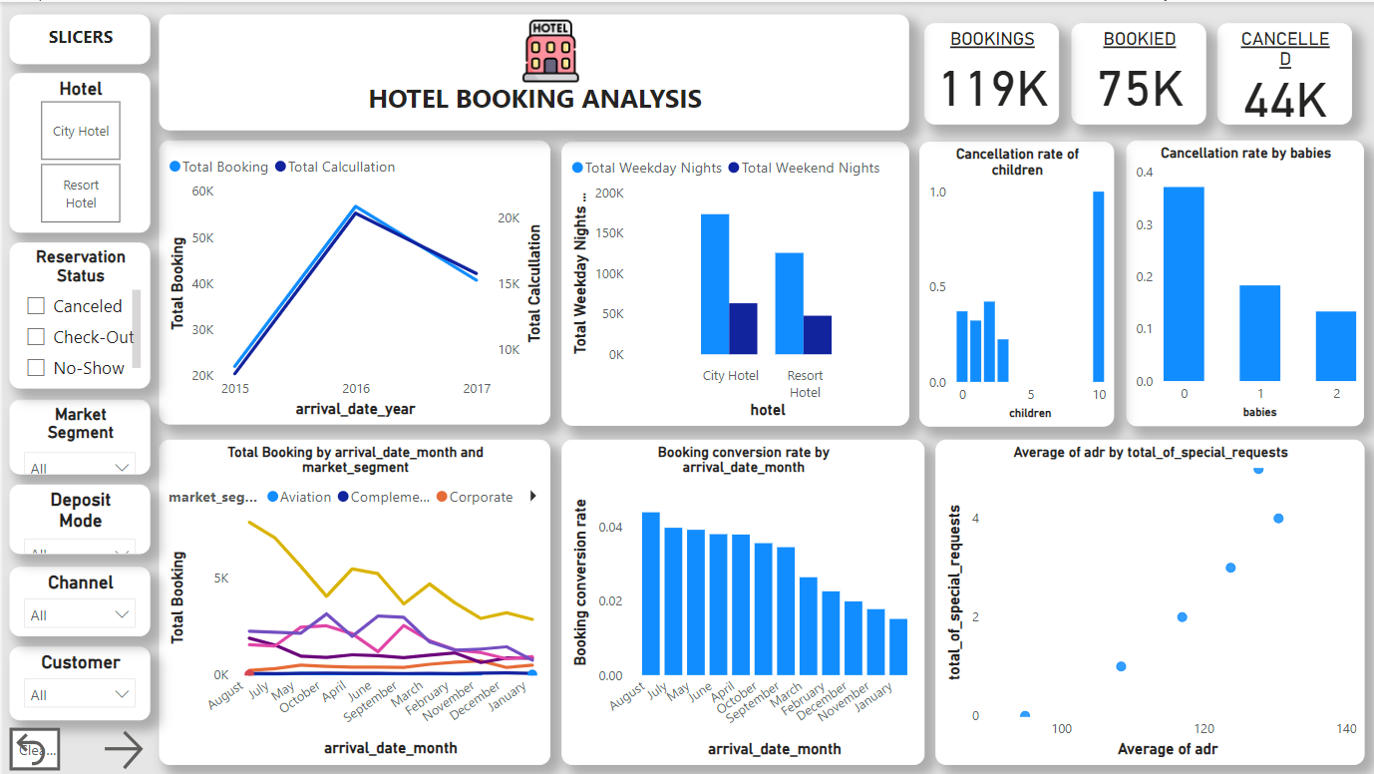
Dashboard
The initial slide of the Power BI dashboard presents a comprehensive overview, featuring total bookings, confirmed reservations, and cancellations. It also incorporates exploratory data analysis (EDA) visuals that offer insights into the dataset. Additionally, slicers are thoughtfully included to provide users with a holistic perspective and interactive control over the data presentation.

Slide 26
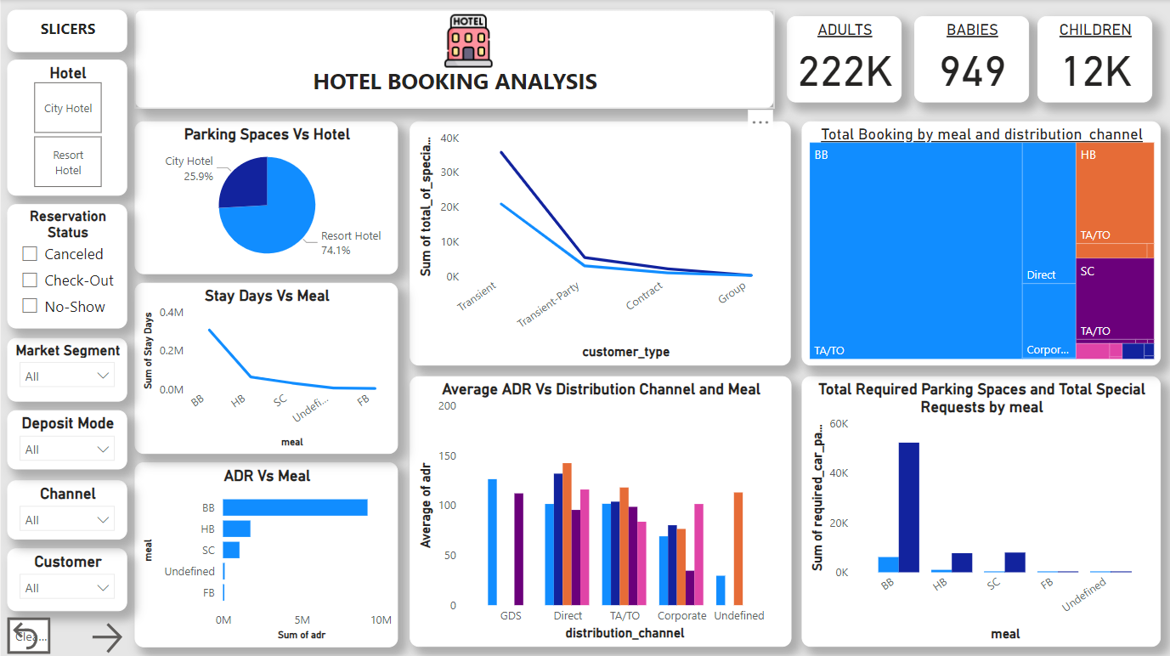
Dashboard Cont….
This dashboard slide showcases key guest details, including counts of adults, children, and babies. It also addresses critical EDA questions regarding required car parking spaces, total special requests, meal preferences, and Average Daily Rate (ADR). Impressively, it maintains consistency with the slicers introduced in the initial slide, ensuring a seamless and user-friendly experience throughout the presentation.

Slide 27
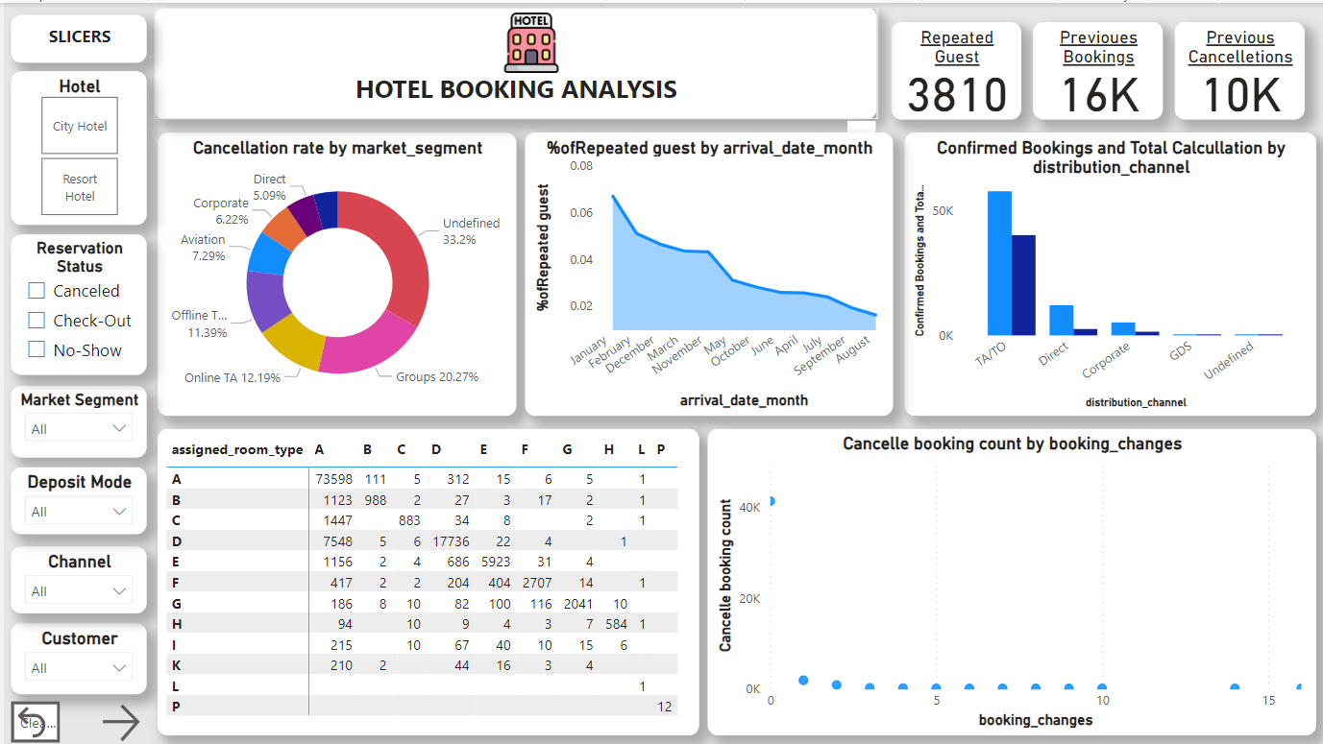
Dashboard Cont….
Slide three of our dashboard offers a comprehensive view of guest information. It sheds light on whether guests are repeat visitors, their historical booking behaviour (including cancellations), and the booking sources they've utilized. Additionally, we delve into customer types and details about the rooms initially reserved and eventually assigned. This cohesive approach allows for a deeper understanding of guest dynamics, historical patterns, and preferences.

Slide 28
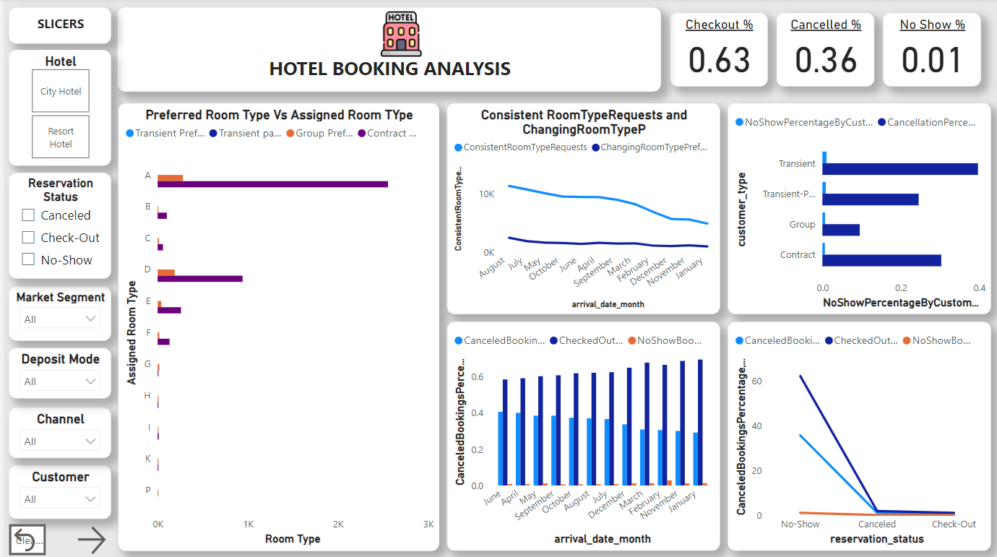
Dashboard Cont….
Our final slide in the dashboard presents a vital overview of reservation statuses, highlighting the percentages of checkouts, cancellations, and no-shows.
This encapsulates the ultimate outcome of hotel reservations. In essence, our holistic hotel booking analysis dashboard offers data-driven insights that serve as a bedrock for informed decision-making and development initiatives.
These insights enable us to steer our strategies in the right direction and optimize our operations for enhanced guest experiences and overall success.

Slide 29
Insights
July and August emerge as the busiest and most profitable months for both hotels.
July august are the most busier and profitable months for both hotels.
City hotels account for approximately 60% of bookings, making them the busier option compared to resort hotels, which represent around 40% of reservations. The city hotel Average daily rate ADR is higher than resort hotel.
Guests tend to favor resort hotels for extended stays and opt for city hotels for shorter durations. The most preferred booking channel is TA/TO.
Interestingly, there are more guests with cars at City hotels (1,926 guests requiring parking spaces) compared to Resort hotels (5,465 guests requiring parking spaces). This suggests that City hotels tend to attract more guests who have vehicles.
While Transient guests make the most requests, Transient-Party and Contract customers also contribute to the total count, with 8,274 and 2,971 requests, respectively.

Slide 30
Insights Cont….
Repeated guests tend to make more special requests, as indicated by higher values in the "total_of_special_requests" column for repeated guest bookings across different distribution channels and market segments.
"Direct" and "Corporate" channels also have a notable presence of repeated guests, with 3,810 and 1,572 bookings, respectively.
The "Groups" market segment stands out with a substantial count of repeated guests at 11,580 bookings, indicating its attractiveness to guests who have stayed before.
In 2017, there was a decrease in both bookings and cancellations compared to 2016, with bookings down by approximately 28.25% and cancellations down by 22.58%. This indicates a reduction in activity from 2016 to 2017.

Slide 31
Insights Cont….
Guests with "3 or More Previous Cancellations" have a lower cancellation rate (approximately 59.94%) than those with "1-2 Previous Cancellations," suggesting a shift towards more committed booking behaviour over time.
Cancellation rates vary notably by customer type, with Transient bookings having the highest rate (~66.96%) and Contract bookings the lowest (~10.62%), indicating a higher likelihood of cancellations for Transient reservations.
The majority of reservations show consistency between the reserved and assigned room types, as indicated by the "Consistent" label. For example, there are 104,473 instances where both reserved and assigned room types are "A," and 14,917 cases of inconsistency.

